Slide 1

Getting Pushy with SignalR and Rx https://github.com/jwooley/SignalrRxSamples https://jwooley.github.io/
Jim Wooley
www.ThinqLinq.com
@jimwooley

Slide 2


Problems with Pull - Web

Slide 3
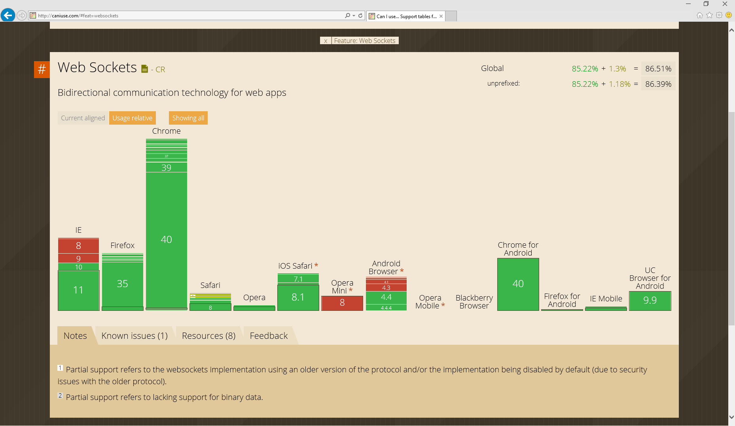
http://caniuse.com/websockets

Slide 4
Getting Pushy with SignalR
SignalR

Slide 5
SignalR for Server Push
Server
Asp.Net
Self-Host
Client
javaScript
.Net
Owin
Java/ObjC
WebSocket
Long Polling
Heartbeat
Server sent events
Forever Frame

Slide 6
SignalR Demo

Slide 7
Chat Server
using Microsoft.AspNetCore.SignalR;
using System.Collections.Generic;
using System.Threading.Tasks;
namespace SignalrAngular.Hubs
{
public class ChatHub : Hub
{
public Task Send(string data)
{
var currentUser = new List<string> { Context.ConnectionId };
return Clients.AllExcept(currentUser).InvokeAsync("Send", data);
}
}
}

Slide 8
Chat Clients
// javascript
var chat = $.connection.chat;
chat.addMessage = function (message) { $('#messages').append('<li>' + message + '</li>');
};
$.connection.hub.start();
$("#broadcast").click(function () { chat.send($('#msg').val());});
// C#
cn = new HubConnection("http://localhost:5687/");
proxy = cn.CreateProxy(“chat");
proxy.On("AddMessage", message =>
Dispatcher.Invoke(new Action(() => chatItems.Add(message)))
);
cn.Start();
private async void BroadcastBtn_Click(object sender, RoutedEventArgs e)
{
await proxy.Invoke("Send", Input.Text);
}

Slide 9
SignalR core architecture: pub/sub
publisher
1. Message serialized, saved to cache associated with signal, topic is marked for delivery, publish call returns
message bus
message cache
3. Worker sends message to client as bytes over a transport
2. Worker is scheduled for a signal, selects a waiting subscriber, retrieves message from cache
worker
worker
worker
client
client
client
client
client

Slide 10
Scale-out provider architecture
backplane
Messages sharded over multiple backplane streams
protected void Application_Start(object sender, EventArgs e)
{
RouteTable.Routes.MapHubs();
GlobalHost.DependencyResolver.UseRedis(server,
port, password, "SignalR.Redis.Sample");
}
web nodes
clients

Slide 11
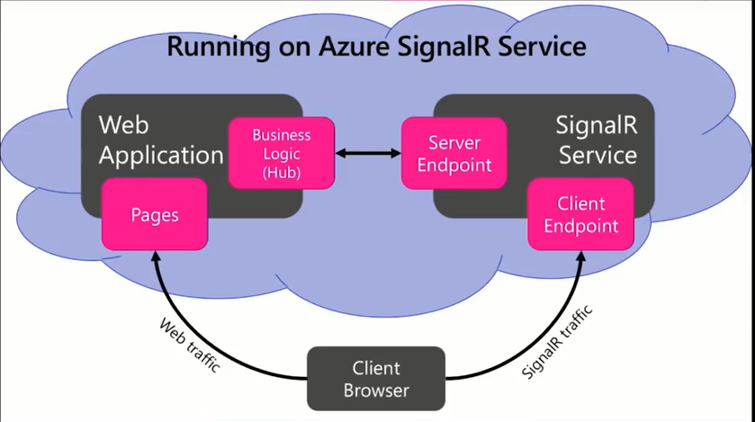

Slide 12
SignalR Core
Replacing GlobalHost with DI
Additional transports (Not just HTTP)
Remove jQuery dependency
Drop ForeverFrame
Separate connection by hub
New client libraries
Binary data support
Azure SignalR Service

Slide 13
SignalR Core Demo

Slide 14
SignalR Core
Preview not shipping until after Core 2.0 Currently 1.0.0-alpha1-final
Replacing GlobalHost with DI
Additional transports (Not just HTTP)
Remove jQuery dependency
Drop ForeverFrame
Separate connection by hub
New client libraries (swift)
Binary data support
http://channel9.msdn.com/Events/Build/2017/B8078

Slide 15
SignalR Core Demo

Slide 16
Programming options
Traditional Strategies
Events
Callbacks
Problems
Nested callbacks
Cancellation
Promises
Async
Testing – Mocking and Injection

Slide 17

Problems with Pull - LINQ
public interface IEnumerator<T>
{
T Current { get; }
bool MoveNext();
void Reset();
}
public interface IObserver<T>
{
void OnCompleted();
void OnError(Exception exception);
void OnNext(T value);
}
Blocking

Slide 18
Reactive Framework
“Rx is a library for
composing asynchronous and
event-based programs using
observable collections.”

Slide 19
Getting Pushy with SignalR and Rx
SignalR
Select : Where : : Map : Filter
Rx
Rx

Slide 20
Rx Demo

Slide 21
Rx Push - Server
Dim rand = New Random(Now.Millisecond)
Dim Generator = Observable.Generate(Of Double, SensorData)(
initialState:=0,
condition:=Function(val) True,
iterate:=Function(val) rand.NextDouble,
resultSelector:=Function(val) New SensorData With
{.Time = Now, .Value = val * 20, .Category = (CInt(val * 4)).ToString() },
timeSelector:=Function(val) TimeSpan.FromSeconds(val))
Dim query = From val In Generator
Where val.Value > 10
Select val
query.Subscribe(Sub(value)
Dim context = GlobalHost.ConnectionManager.
GetHubContext(Of ObservableSensorHub)()
context.Clients.Broadcast(value)
End Sub)

Slide 22
RX Push - Client
Dim cn = New HubConnection("http://localhost:5687")
Dim sensor = cn.CreateProxy("observableSensorHub")
Dim items = From item In sensor.Observe("broadcast")
Let instance = item(0).ToObject(Of SensorData)()
Where instance.Category = "1"
Select instance
Using items.Subscribe(Sub(value) Console.WriteLine(value.Value))
cn.Start().Wait()
Console.ReadLine()
End Using

Slide 23
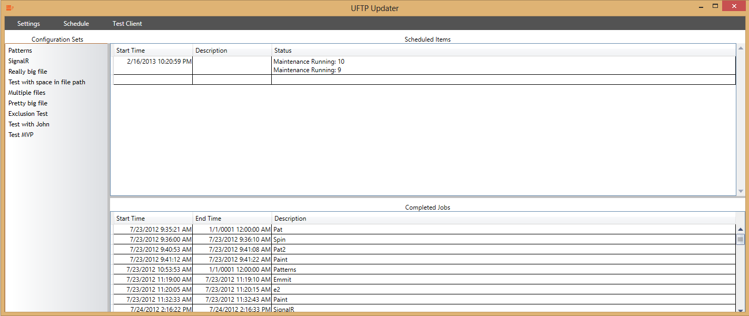
Demo – SignalR & RX

Slide 24





Flavors of Rx
RxJs
Rx-Cpp
F#
RxSwift
Rx.RB
Rx.Py
Haskell - FRP
Reactive Scala/MongoDB
RxJava
RxPhp
Rx-Perl

Slide 25


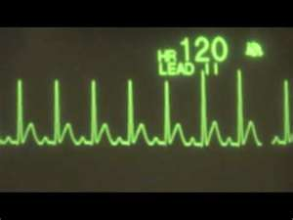

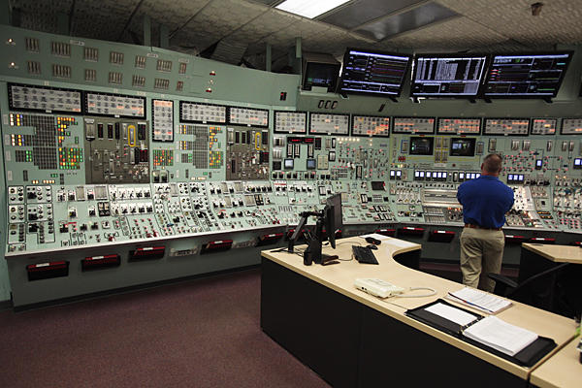
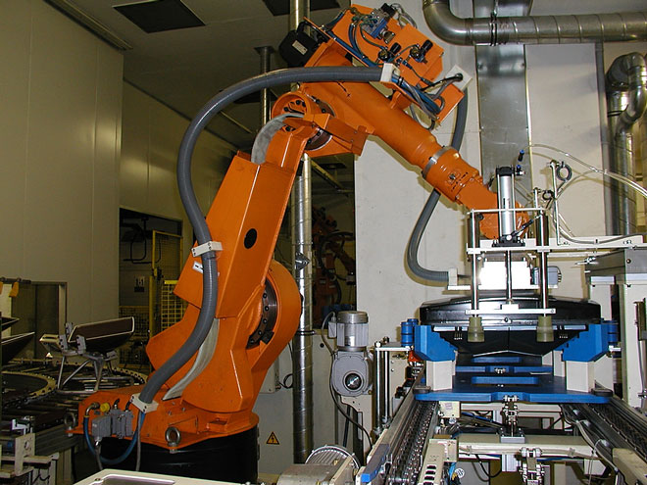

Common Uses

Slide 26
Resources
SignalR
RX
JabbR
ShootR
@DavidFowl
@DamienEdwards
Free Ebook
Team Blog
Source
Paper.li
@ReactiveX
Free Ebook

Slide 27
https://github.com/jwooley/SignalrRxSamples Questions
Jim Wooley
www.ThinqLinq.com
@jimwooley

